Slide 1

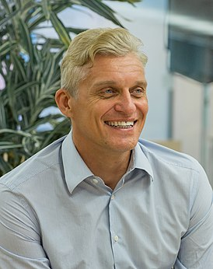

I want to tell you about Oleg Tinkoff.
He is the founder of T-Bank.
He was born in the Kemerovo region.
He was born on December 25, 1967.
He is now 56 years old.

Slide 2
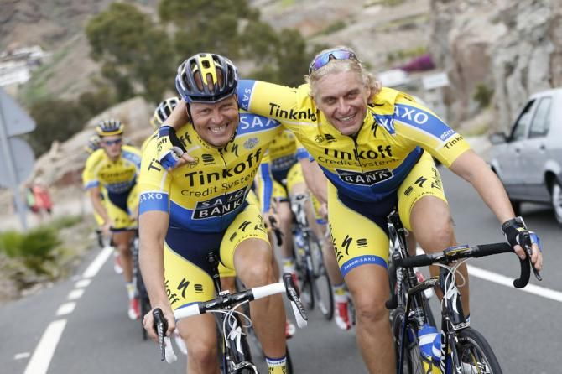
He has his own cycling team.
He was able to recover from Leukemia.

Slide 3


Thank you for your attention!
Prepared by:
Andrey Anufriev.

